Slide 1


Raghu Engineering Collage (A)
Bachelor of Technology
Department of Computer science Engineering
MOVIE EXPLORER
A Web-Based Mini Project submitted for [Computer science Engineering/ 3-1]
Presented by Team-14. CSE AI-ML
Guided by K. Sandeep Kumar
Presented By:
Tagaram Sonalika (TL)-24981A428P
Chenna Varun-24981A246U
Mamidi Rishith kumar-24981A4251
Gutti indu valani-24981A424Y
Chodisetti tejeswararao-24981A426X
Head Of Department
Dr. G. Sridevi
Guided By:
Mr. K. Sandeep Kumar M. Tech

Slide 2
Contents:
Project Overview
Problem Statement
Objectives
Technologies Used
Key Features
Responsive Design
Benefits & Learning Outcomes
Conclusion
HTML • CSS • JavaScript

Slide 3
MOVIE EXPLORER
A responsive web-based application for browsing, searching, filtering, sorting, and exploring movie information.
HTML • CSS • JavaScript

Slide 4
Project Overview
A structured and accessible platform for interactive movie exploration
Purpose
Core Objective
User Experience
Provides a simple interface for browsing and examining a collection of movies.
Demonstrates practical front-end development concepts using a single client-side application.
Reduces the effort required to locate movies and explore relevant information.
The application combines structure, presentation, data handling, and interaction into one responsive system.

Slide 5
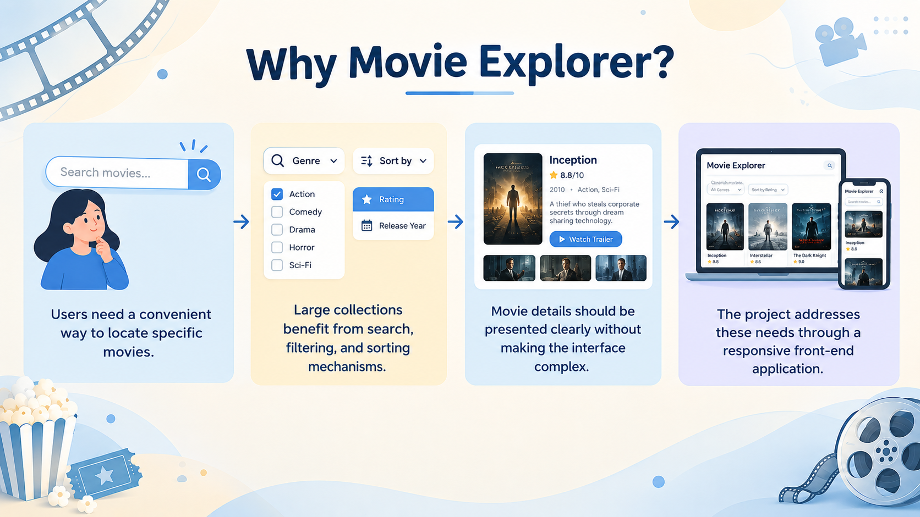
Problem Statement
Movie collections can become difficult to browse when information is not organized effectively
• Users need a convenient way to locate specific movies.
• Large collections benefit from search, filtering, and sorting mechanisms.
• Movie details should be presented clearly without making the interface complex.
• The project addresses these needs through a responsive front-end application.

Slide 6
Objectives
What the Movie Explorer is designed to achieve
Organize
Search
Filter
Present movie data in a structured and accessible collection.
Allow users to quickly find movies by title.
Narrow results according to movie genre.
Sort
Explore
Demonstrate
Arrange movies by rating or release year.
Provide access to detailed movie information.
Apply core HTML, CSS, and JavaScript concepts.

Slide 7
Technologies Used
The project is implemented exclusively with front-end web technologies
HTML
CSS
JavaScript
Defines semantic structure, content organization, and the application layout.
Handles presentation, visual styling, layout, responsiveness, Grid, and Flexbox.
Provides dynamic behavior, data handling, DOM manipulation, and event-driven interaction.
No server-side framework is required for the core application.

Slide 8
System Architecture
How the main front-end components work together
Movie Data
JavaScript Logic
HTML + CSS UI
Arrays and objects store the movie collection and its attributes.
Search, filtering, sorting, events, and DOM updates process user actions.
The processed data is rendered into a responsive, user-friendly interface.
User Action → JavaScript Processing → DOM Update → Updated Movie Collection

Slide 9
Key Features
Interactive capabilities provided by the application
Movie Search
Genre Filter
Rating Sort
Search by title to locate a particular movie.
Display movies belonging to a selected genre.
Organize the collection according to movie ratings.
Year Sort
Movie Details
Dynamic Updates
Arrange movies by release year.
Interact with components to examine detailed information.
Refresh displayed results without rebuilding the page.

Slide 10
Search, Filter & Sort Workflow
User actions dynamically update the visible movie collection
1
→
2
→
3
→
4
Enter Search
Apply Filter
Choose Sort
View Results
User enters a movie title or keyword.
Genre selection narrows the collection.
Rating or release year determines ordering.
JavaScript updates the DOM with matching movies.

Slide 11
Responsive Design
The interface adapts to different screen sizes
CSS Grid
Flexbox
Responsive UI
Supports structured page layouts and adaptive movie-card arrangements.
Provides flexible alignment and distribution of interface elements.
Helps maintain usability across desktop, tablet, and smaller displays.
Goal: maintain a clean, readable, and accessible experience across screen sizes.

Slide 12
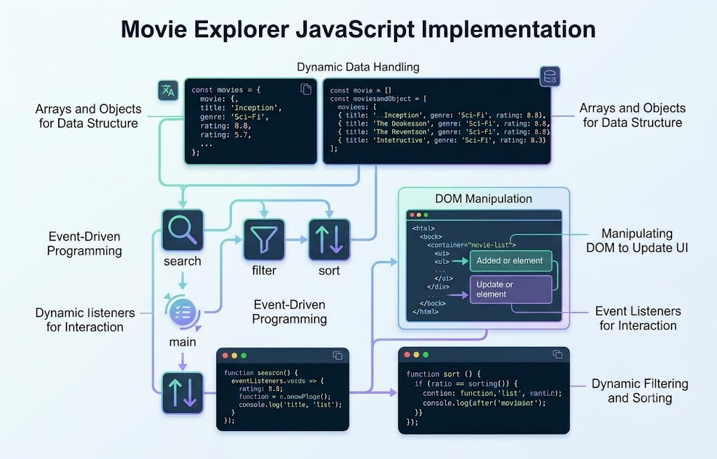
JavaScript Implementation
Dynamic behavior is driven by data and event-based programming
• Movie information is represented using JavaScript arrays and objects.
• DOM manipulation updates movie cards and visible results dynamically.
• Event-driven programming responds to searches, filter selections, and sorting actions.
• The page structure remains stable while the displayed collection changes.

Slide 13
Benefits & Learning Outcomes
Practical front-end development skills demonstrated by the project
Data Handling
DOM Manipulation
Event Handling
Managing structured movie information with arrays and objects.
Creating and updating page content programmatically.
Connecting user actions to application behavior.
Responsive Layout
UI Design
Applying Grid, Flexbox, and responsive design principles.
Building an organized and user-friendly interface.

Slide 14
Future Enhancements
Possible extensions while retaining the same core front-end technologies
• Expand the movie dataset with additional titles and metadata.
• Add richer movie detail views, trailers, cast information, and ratings.
• Introduce favorites or watchlist functionality using browser storage.
• Improve accessibility and add more advanced responsive interactions.
• Connect to a movie API in a future version for live and larger datasets.

Slide 15
Conclusion
Movie Explorer integrates structure, styling, data, and interaction into one front-end system
The project demonstrates how HTML, CSS, and JavaScript can be combined to build a practical and responsive movie browsing application.
Through search, genre filtering, sorting, and interactive movie details, the application provides an efficient way to explore a movie collection while strengthening core client-side web development skills.

Slide 16
THANK YOU

